Slide 1
Deepfake Detection
Marc Laugharn

Slide 2
Problem statement
Detecting whether a video is a deepfake or not

Slide 3
Previously
Model trained on full frames of video
ResNet
Lots of non-specific augmentations (excessive blur, warp)
Up to 75% accuracy

Slide 4
Insights
Using whole frame as input to model is too confusing (by not focusing on faces)
Augmentations boost performance of learners with limited examples
Faces are non-uniformly manipulated, so compare different parts of the same face
Rely upon geometry of faces
Some previously-used augmentations were confusing model (eg warp)
Use a standard set of landmarks for each face
Dataset doesn’t have enough examples to train a ResNet properly

Slide 5
Strategy
Limit focus to faces
Exploit geometry
Pick a better-suited convolutional neural net (ie fewer parameters, not a general-purpose object recognizer)

Slide 6
Data preprocessing
15 frames extracted from video (10 before)
MTCNN to extract each face from each frame (multiple people in a frame -> multiple images)
Include if > 90% confidence of face
30% margin
Faces resized to 300x300
By hand:
Removing spurious faces (eg. backgrounds, faces on tshirts)
Removing real person from fake set if fake video has both real person and fake person present simultaneously

Slide 7
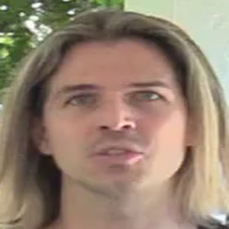
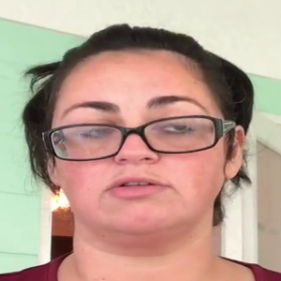
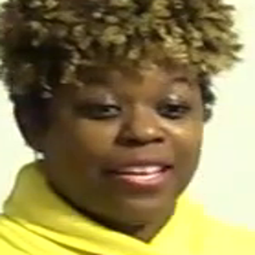
Real faces

Slide 8
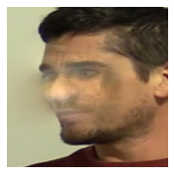
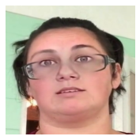
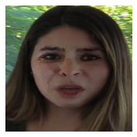
Fake faces

Slide 9
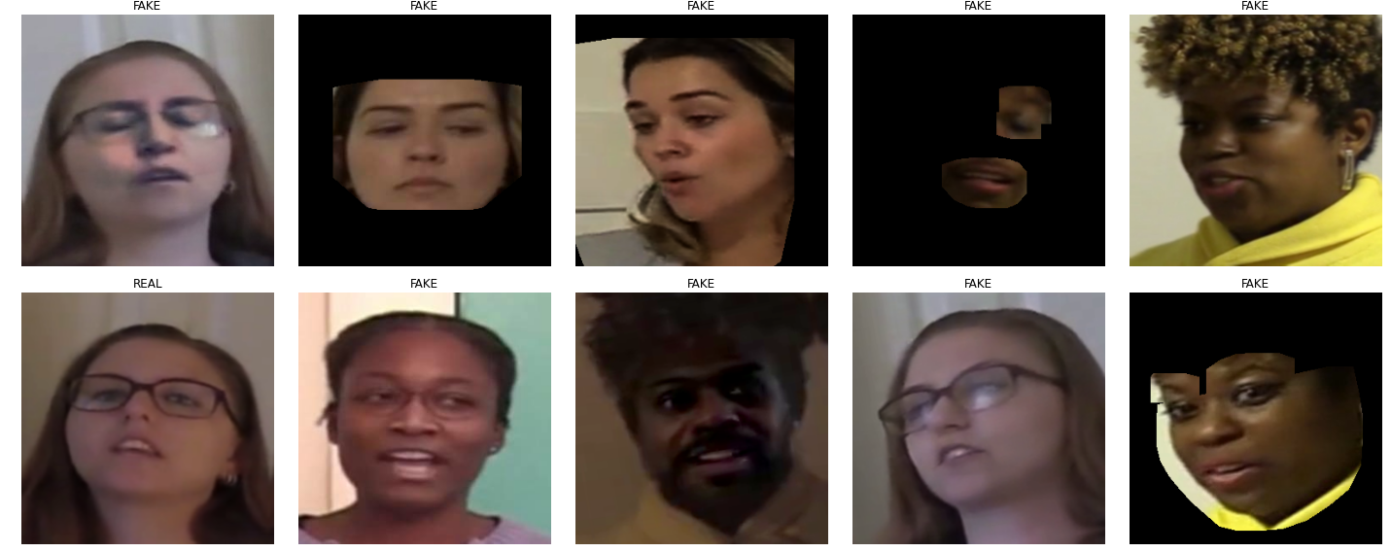
Batch w/ augmentations

Slide 10
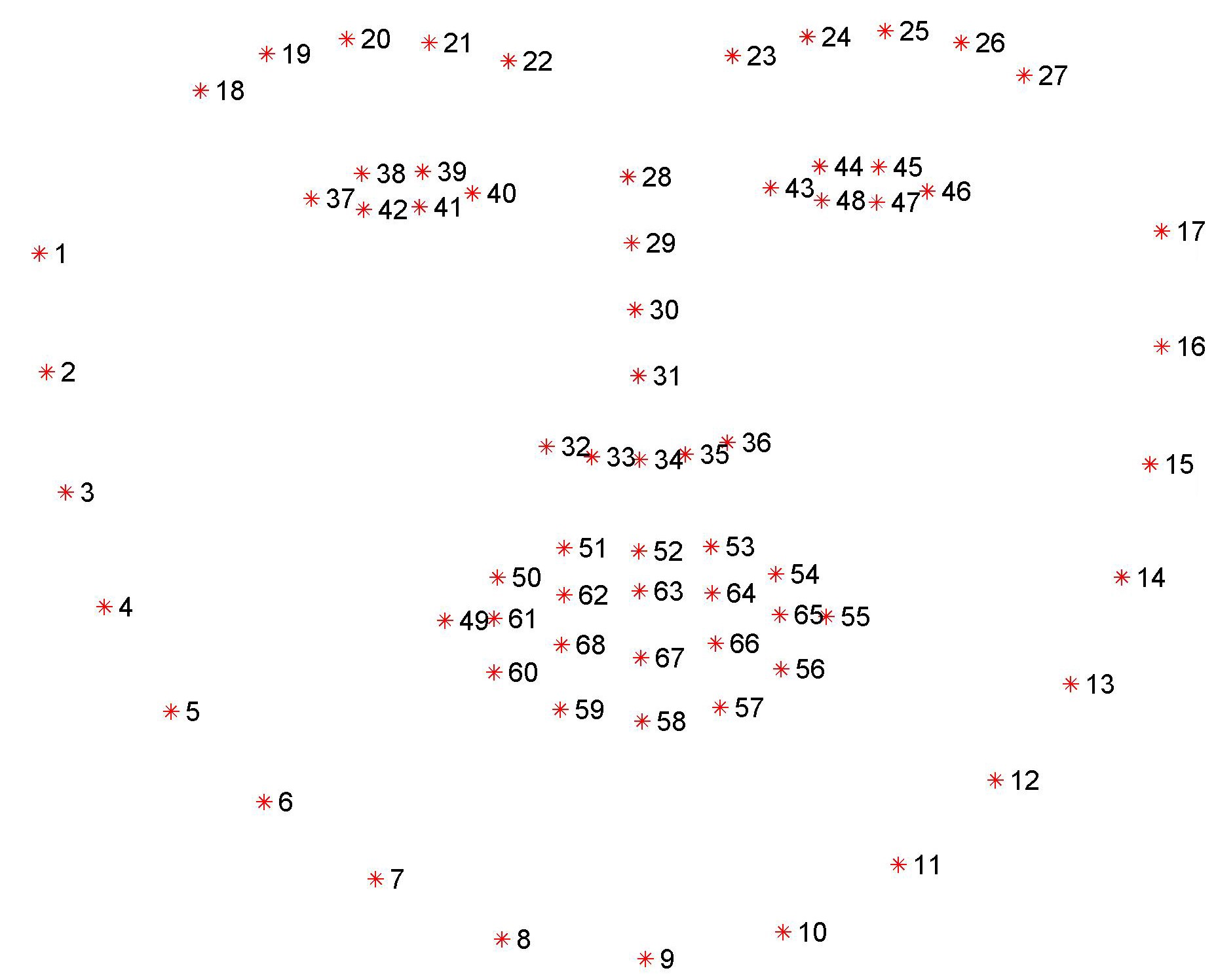
Exploiting face geometry via landmark points
Based on facial landmarks w/ dlib
40% of the time:
Create the convex hulls of either
3 random facial features, or
Single random interval of landmark points
Then, dilate the resulting mask by a random amount, between once and 3 times
Mask original cropped image with generated mask
Explanation of improvement
Much more focus on facial features vs crop of face; we reduce loss solely due to contents of face
Random interval likely preserves connecting spaces between facial features
Triples of features preserves some of the geometric relationships between facial features, and allows for checking consistency of face between regions
Hair is not typically deepfaked and appears to confuse the model, so ignore hair that would otherwise be included in face bounding box
Dilation allows inclusion of boundary artefacts

Slide 11
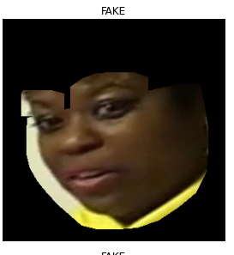
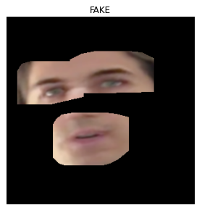
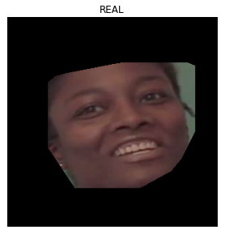
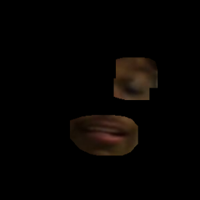
Example of facial geometry-aware augmentations

Slide 12
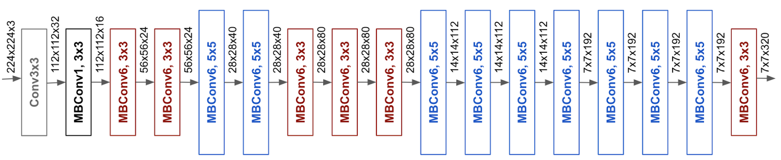
Model complexity & performance
ResNet: 20M parameters, ~80% accurate
EfficientNet: high accuracy and lower number of parameters
EfficientNet-b3 (12M parameters) and EfficientNet-b5 (30M parameters)
B3: 90% accurate (92% w/ augmentations)
B5: 95.5% accurate (w/ augmentations)
Successively fewer, successively larger convolutions
Last B5 layer is densely connected, 2048 -> 2
Efficientnet-b0

Slide 13
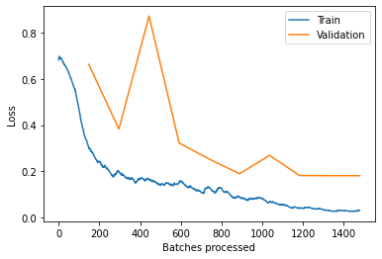
Loss over batches

Slide 14
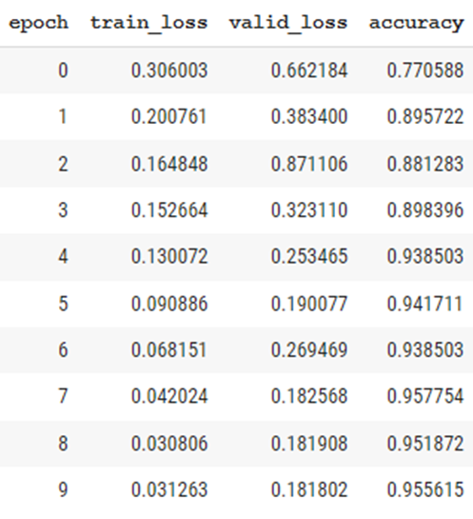
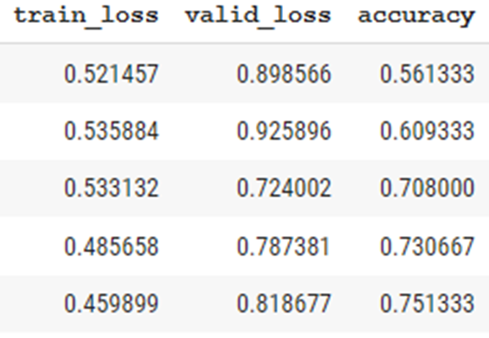
Comparison final midterm

Slide 15
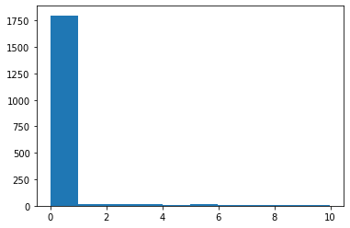
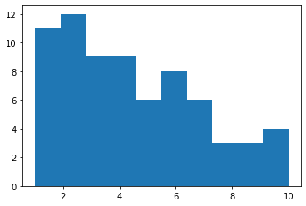
Performance: histogram of validation losses
Histogram of validation losses, and with loss < 1 removed
This (and going through dataset by hand) suggests lots of spurious examples in fake dataset (many thousands of images) still need to be manually removed
Most worst-loss faces came from videos featuring 2 people, suggesting real person still present in fake set

Slide 16
Remarks
Cleaning dataset by far the most laborious part of process
Model probably has significant room for improvement w/ cleaner data
Geometry awareness improved validation loss convergence behavior
Quite fast: model trained in 10 epochs in 50 minutes
Unfortunately unable to get gradient visualization working w/ EfficientNet

Slide 17
Conclusion
Exploit geometry
Focus on relevant features and discard the rest

